Slide 1

Image processing
Using Deep Learning Models​

Slide 2

Agenda
What is Image processing?
Deep Learning Models
Training a Model
Explainable AI

Slide 3
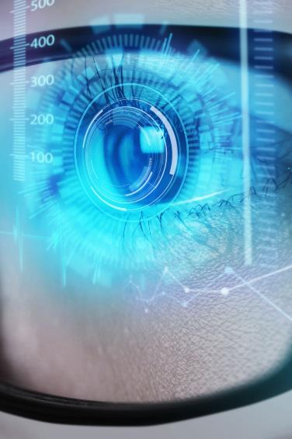
Image processing
Image processing is the technique of performing operations on images to enhance, analyze, and manipulate their content. It involves methods for transforming images into digital formats, improving image quality, and extracting meaningful information through algorithms and computational techniques

Slide 4


Image classification
Gray scale
RGB
Black and White
Red Green and Blue (colorful)

Slide 5

Image classification
Pixels
Suppose a image has ratio 480p
Which means 480p=640X480
480p= 307200 pixels

Slide 6

Deep learning
Deep learning is a subset of machine learning that uses multi-layered neural networks, called deep neural networks, to simulate the complex decision-making power of the human brain. Some form of deep learning powers most of the artificial intelligence (AI) in our lives today.

Slide 7
Deep learning model
CNN
Convolutional neural network
GAN Generative adversarial network
RNN Recurrent Neural Network
General image classification
Segmentation
Detection tasks​
Example includes ResNet, VGG
Image synthesis and enhancement​
Example includes CycleGAN
Dynamic imaging studies like functional MRI
Example includes LSTM, GRU​
​

Slide 8
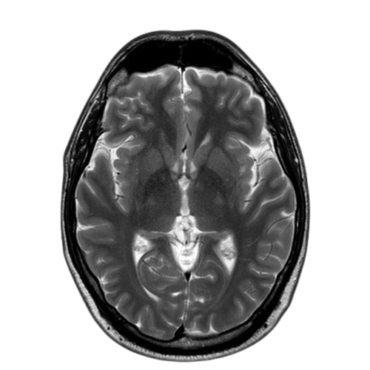
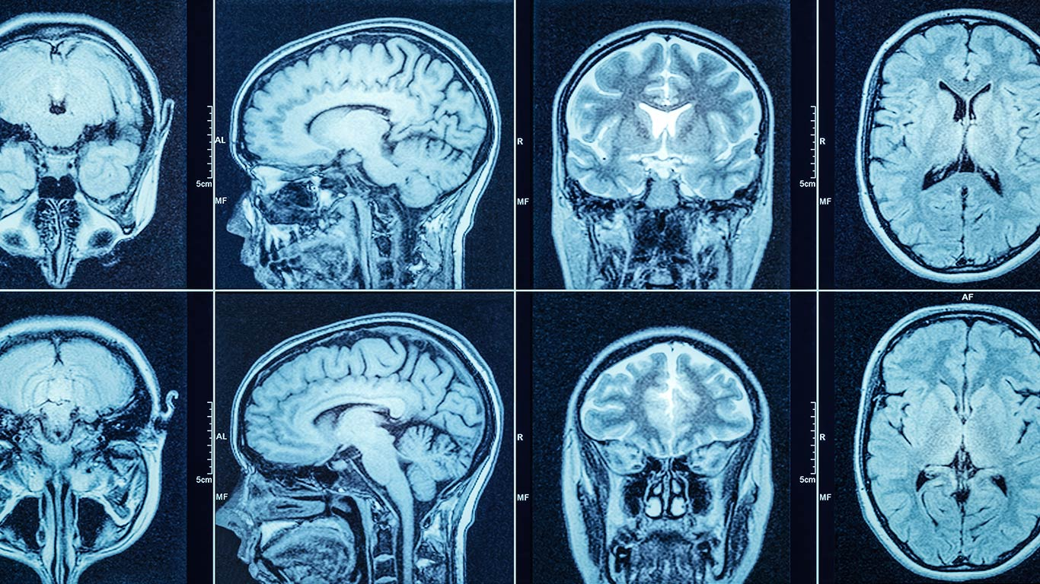
Deep learning model
3d-cnn
Analyzing volumetric data such as MRI, CT-Scan etc.
Example includes 3D-U-Net

Slide 9
How to train a model
Using Deep Learning
Data Collection
Data preprocessing
Model selection
Model training
Collect large label dataset
Data annotation
Normalization
Resizing
Augmentation
segmentation
CNN (Convolutional Neural Network)
Pretrained Model
Define CNN Architecture
Loss Function
Evaluation and validation
Model interpretation
deployment
Continuous learning and improvement
Use matrices like Accuracy, Precision, F1-score
Use Grad-CAM to generate the heatmaps that highlight the region in the image (eg, x-ray)
Feedback loop, the radiologists provide corrections on model predictions.
Integrate the trained model with the clinical decision support system or deploy it standalone.
Make UI for doctor to upload images to view model prediction

Slide 10
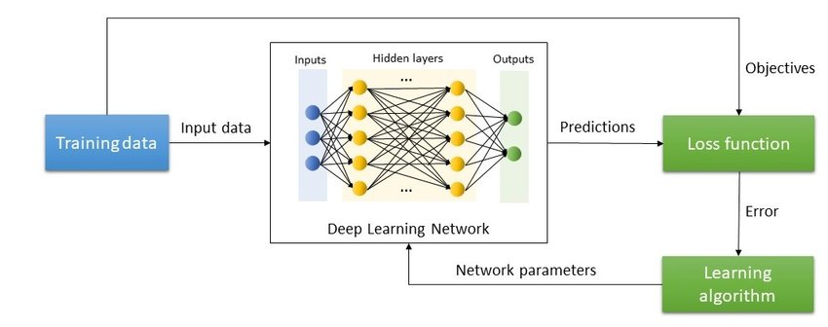
Model training process
Forecasting for success​

Slide 11

Explainable Ai

Slide 12

Explainable Ai (X-Ai)
Explainable AI (X-AI) models are designed to make the decision-making processes of AI systems transparent, understandable, and interpretable to humans. These models aim to provide insights into how AI algorithms reach their conclusion which is critical for building trust, ensuring accountability, and facilitating debugging and improvement.

Slide 13
X-Ai Models
LIME (Local Interpretable Model-agnostic Explanations)
SHAP (SHapley Additive exPlanations)
Grad-CAM (Gradient-weighted Class Activation Mapping)
Integrated Gradients
DeepLIFT (Deep Learning Important Features)
Layer-wise Relevance Propagation (LRP)
Counterfactual Explanations
Explainable Boosting Machine (EBM)
Rule-based Models (e.g., Decision Trees, Rule Lists)

Slide 14

Thank you

